Slide 1
Reading Wikipedia to Answer Open-Domain Questions
严德美
2017年4月11日

Slide 2
Outline
Introduction
Document Retriever(find the relevant articles)
Document Reader(identifying the answer spans)
Experiment
Conclusion

Slide 3
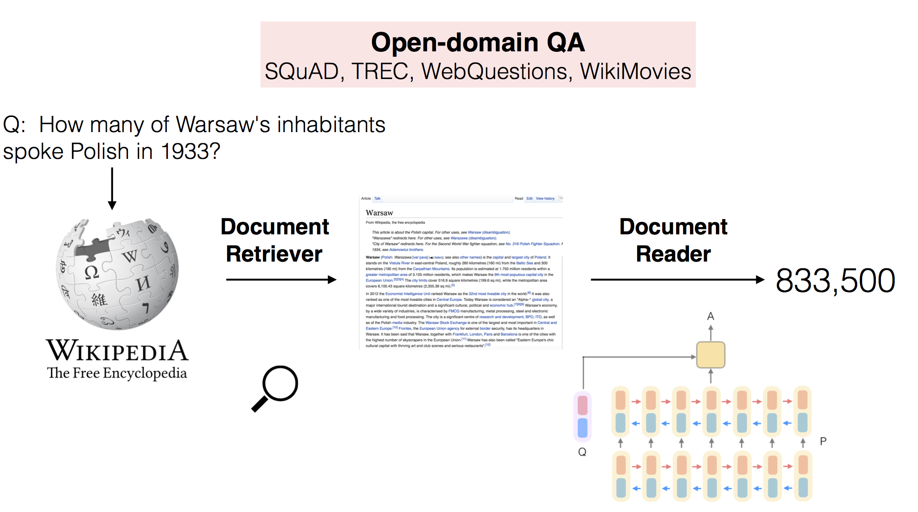

Slide 4
Introduction
Not rely on its internal graph structure(as a collection of articles)
more general method
answering factoid questions in an open-domain setting
using Wikipedia as the unique knowledge source
Notes:
generic, could be switched to other collections of documents, books, or even daily updated newspapers.

Slide 5
Document Retriever
articles and questions are compared as TF-IDF weighted bag-of-word vectors
uses bigram counts
return 5 Wikipedia articles given any question

Slide 6

Document Reader
a question q $→l$tokens {$q_{1}$,…, $q_{l}$} , a paragraph p$→$ m tokens {$p_{1},…,p_{m}$}
Paragraph encoding
Question encoding
Prediction

Slide 7




Paragraph encoding
300-dimensional
3-dimensional
original, lowercase or lemma form
term frequency (TF)
is single dense layer with ReLU nonlinearity
Notes:
align compared to the exact match features, these features add soft alignments between similar but non-identical words
(e.g., car and vehicle).
aij captures the similarity between pi and each question words qj

Slide 8

Question encoding
a token $q_{i}\underset{→}{emb} q_{i}$
$\{q_{1},…,q_{l}\}$ $\underset{→}{RNN}$ $q$ $q=\sum_{j}{b_{j}q_{j}}$ $b_{j}=\frac{exp(w∙q_{j})}{\sum_{j^{′}}{exp(w∙q_{j^{′}})}}$
Notes:
W is a weight vector to learn

Slide 9
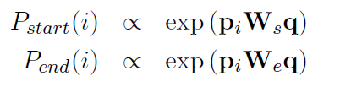
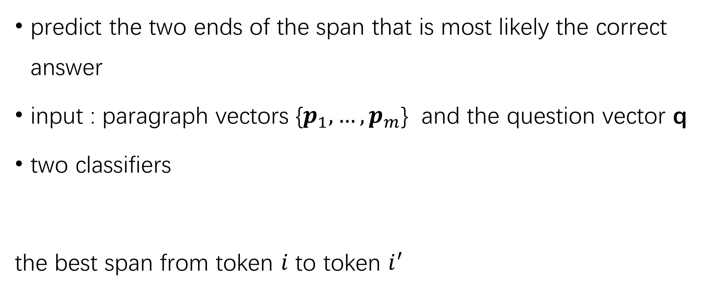
Prediction
predict the two ends of the span that is most likely the correct answer
input : paragraph vectors {$p_{1},…,p_{m}$} and the question vector q
two classifiers
the best span from token $i$ to token $i^{′}$

Slide 10
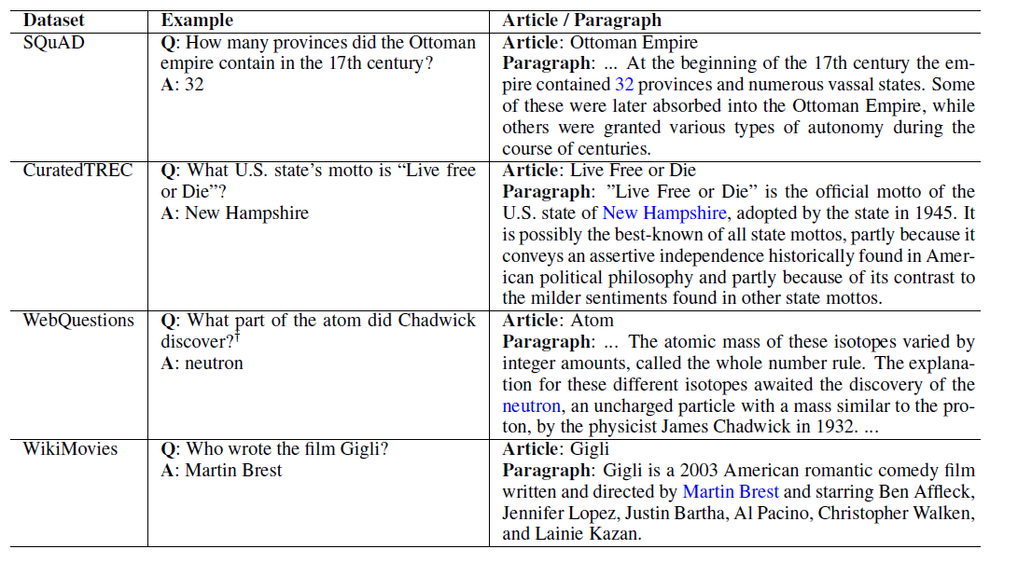

Slide 11
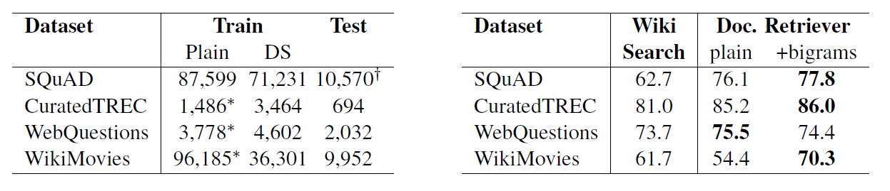
Notes:
Number of questions for each dataset used in this paper.
DS: distantly supervised training data.
*: These training sets are not used as is because no paragraph is associated with each question.
†: Corresponds to SQuAD development set.
Document retrieval results. % of questions
for which the answer segment appears in one
of the top 5 pages returned by the method.

Slide 12
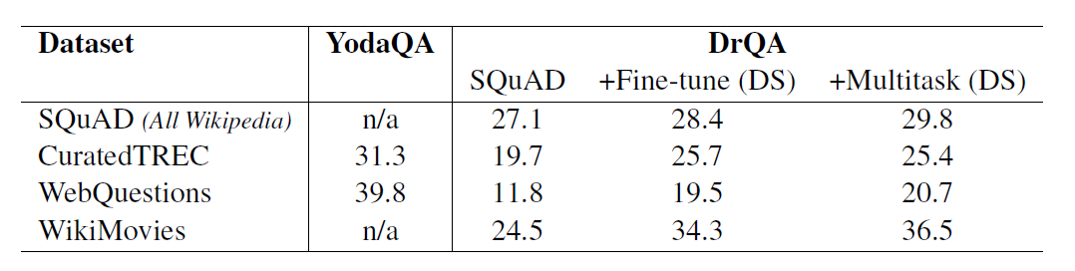
Experiment
two evaluation metrics : exact string match(EM) and F1 score
Notes:
SQuAD: A single Document Reader model is
trained on the SQuAD training set only and
used on all evaluation sets.
Fine-tune (DS): A Document Reader model
is pre-trained on SQuAD and then fine-tuned
for each dataset independently using its distant
supervision (DS) training set.
Multitask (DS): A single Document Reader
model is jointly trained on the SQuAD training
set and all the DS sources.

Slide 13
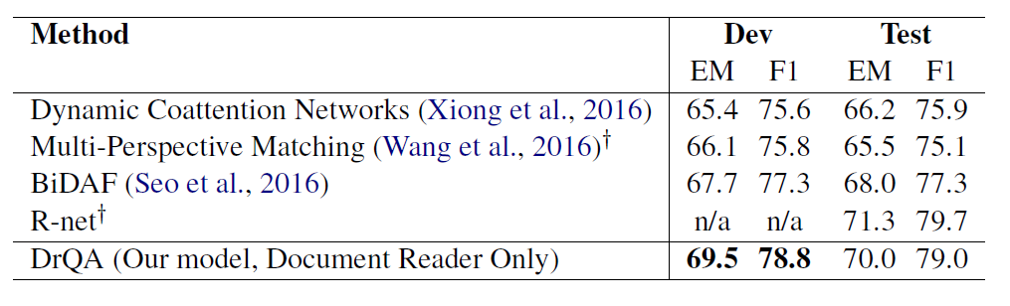
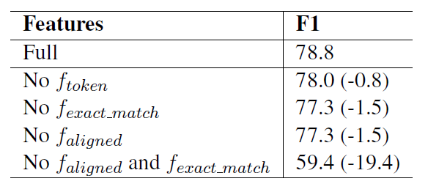
Experiment
Notes:
both features play a similar but complementary role in the feature representation
related to the paraphrased nature of a question

Slide 14
Conclusion
feature
using Wikipedia as the unique knowledge source
novel method
correct paragraph 69.5% , correct document 49.4% , none 27.1%
20.1%
22.3%
Notes:
many false positives come from highly topical sentences

Slide 15
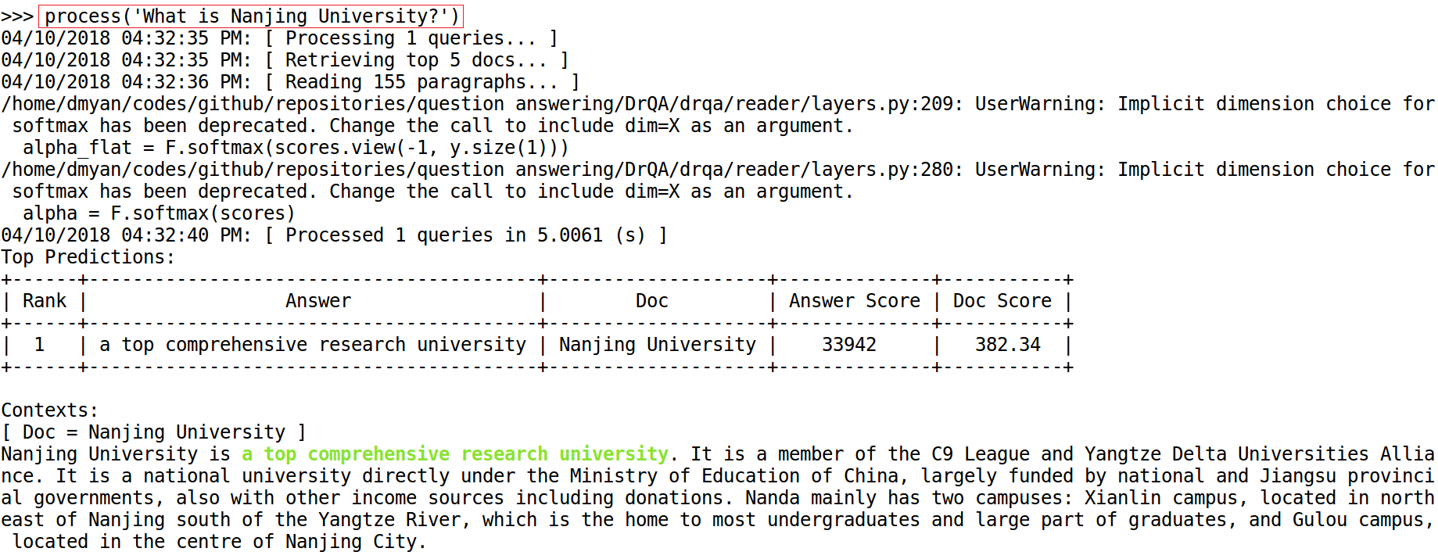
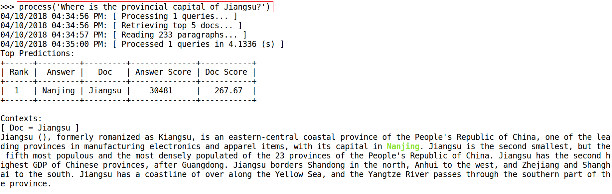

Slide 16
Q & A

